Slide 1

HE5091
Principles of Economics
Lecture 11
Aggregate Demand, Aggregate Supply and Macroeconomic Policy
Tan Khay Boon
Email: khayboon@ntu.edu.sg

Slide 2
Topics
The Aggregate Demand Curve
The Aggregate Supply Curve
Aggregate Demand-Aggregate Supply Analysis
Anti-inflationary Monetary Policy
Response to Aggregate Demand Shock
Response to Aggregate Supply Shock
Reference: FBAH or FBL, chapters 24 & 25

Slide 3

Aggregate Demand and Aggregate Supply
Analyze fluctuations in both output and the inflation rate
  Short run and long run analysis
Inflation rate (Π) and output (Y) on the axis
AD shows the relationship
between planned spending
and the inflation rate
AS shows how output
produced by firms depends
on the inflation rate
Potential output (Y*) is
shown to measure output
gaps
Aggregate Supply (AS)
Inflation (π)
Aggregate Demand (AD)
Y*
Output Y

Slide 4
Long-Run Equilibrium
In the long run,
  Actual output equals potential output
  Actual inflation rate equals expected price level
Long-run equilibrium
occurs at the intersection of
  Aggregate demand
  Aggregate supply and
  Potential output
Aggregate Supply(AS)
Inflation (π)
Aggregate Demand (AD)
Y*
Output Y

Slide 5
Short-Run Equilibrium:
Contractionary Gap
Short-run equilibrium occurs when the AD and AS curves intersect at a level of output different from Y*
  Point A in the graph
  Contractionary Gap
  Actual output is less
  than potential output
  Slow or negative growth
  Unemployment occurs
AS
Inflation (π)
A
π₁
AD
Y₁
Y*
Output Y

Slide 6
Short-Run Equilibrium:
Expansionary Gap
Short-run equilibrium occurs when the AD and AS curves intersect at a level of output different from Y*
  Point B in the graph
  Expansionary Gap
  Actual output is larger
  than potential output
  Excess growth
  Inflationary
AS
Inflation (π)
B
π₂
AD
Y*
Y₂
Output Y

Slide 7
Adjustment to Long-Run Equilibrium
Short-run equilibrium is temporary
Caused by a shift in either AD or AS
Eventually market will move to long run equilibrium
AS shifts to close output
gap through self correcting
mechanism
Inflation can take high
or low level
Actual output equals
potential output
AS
Inflation (π)
π_{E}
E
AD
Y_{E} = Y*
Output Y

Slide 8
The Aggregate Demand Curve
The aggregate demand (AD) curve shows the amount of output consumers, firms, government, and customers abroad want to purchase at each inflation rate
  All else the same
  Slopes downwards
  A higher inflation rate reduces planned aggregate expenditure which reduces output via the multiplier effect
C, I^{p},NX⇓
Y ⇓
PAE ⇓

Slide 9
Shifts in AD Curve
A shift of the aggregate demand curve is called a change in aggregate demand
At the given inflation rate, something causes output to rise (an increase in aggregate demand) or fall (a decrease in aggregate demand)
Two main causes:
  Demand shocks
  Stabilization policy

Slide 10
Shifts in AD Curve
Demand shocks are changes in planned spending not caused by a change in output or a change in the inflation rate
  Consumer confidence
  Consumer wealth
  Business confidence
  Opportunities for firms
  to purchase new
  technologies
  Foreign demand for
  domestic goods
Inflation (π)
AD'
AD
Output (Y)

Slide 11
Shifts in AD Curve
Stabilization policies are government policies used to affect planned aggregate expenditure and eliminate output gaps
Fiscal policy
  Change in government
  spending or taxes
Monetary policy
  Change in the nominal
  money supply which
  changes the interest
  rate
Inflation (π)
AD'
AD
Output (Y)

Slide 12
The Aggregate Supply Curve
The aggregate supply curve (AS) shows the relationship between the amount of output firms want to produce and the inflation rate
  Holds all other factors constant
The aggregate supply curve is upward sloping
  An increase in aggregate demand will increase the willingness to supply and increase the inflation rate
In past chapters firms met demand at present prices
  Holds in the very short run
  Not possible to indefinitely hold inflation constant and increase output

Slide 13
The Aggregate Supply Curve
Some firms have high menu costs
  Costly to change price
Some firms have very low menu costs
  Internet retailers
  Can increase price immediately in response to an increase in aggregate demand
To produce more output, some firms need to eventually charge higher prices
  Overworked resources
Movement along the AS curve is related to inflation inertia and output gaps

Slide 14
Inflation Inertia
Inflation will remain relatively constant, have inertia, as long as the economy is at potential output and there are no external shocks to the price level
Two closely related factors that play an important role in determining the inflation rate
  Inflation expectations
  Long-term wage and price contracts

Slide 15
Inflation Expectations
Today's expectations affect tomorrow's inflation
  Inflation expectations are built into the pricing in multi-period contracts
The higher the expected
rate of inflation, the more
nominal wages and the
cost of other inputs will
increase
  With rising input costs,
  firms increase their
  prices to cover costs
Low Inflation
Low Expected Inflation
Slow Increase in Wages and Production Costs

Slide 16
Expected Inflation
Expectations are influenced by recent experience
  If inflation is low and stable, people expect that to continue
  Volatile inflation leads
  to volatile expectations
Low and stable inflation
creates a virtuous circle
that keeps inflation low
High and unstable inflation
creates a vicious circle
that keeps inflation high
Low Inflation
Low Expected Inflation
Slow Increase in Wages and Production Costs

Slide 17
The Role of Long-Term Contracts
Long-term contracts reduce the cost of negotiations between buyers and sellers
  Labor contracts may be multi-year agreements
  Supply agreements, particularly for high cost inputs, extend over several years
Long-term contracts build in wage and price increases that build in current expectations about inflation
In the absence of external shocks, inflation tends to be stable over time

Slide 18
The Output Gap and Inflation
Relationship of Output to Potential Output | Behavior of Inflation
Expansionary gap Y > Y* | Inflation increases
No output gap Y = Y* | Inflation is stable
Recessionary gap Y < Y* | Inflation decreases

Slide 19
The Aggregate Supply Curve
    Current inflation (π) = expected inflation (π^{e}) +
    inflation from an output gap
If the economy is operating at potential output, then
π = π^{e =} π₁ at A
If the economy has an
expansionary gap, Y>Y*
and π₂ > π^{e} at B
If the economy has a
recessionary gap,
Y < Y* and π₃ < π^{e} at C
The AS curve slopes up
Aggregate Supply (AS)
B
π₂
Inflation (π)
π₁
A
π₃
C
Y₂
Y*
Y₁
Output (Y)

Slide 20

Shifts in the AS Curve
A change in aggregate supply is a shift of the aggregate supply curve
An increase in aggregate supply is a rightward shift of the curve
A decrease in aggregate
supply is a leftward
shift of the curve
Three main causes
  Changes in available
  resources and technology
  Changes in inflation
  expectations
  Inflation shock
AS₂
AS₁
Inflation (π)
$π$₁
Y*
Output Y

Slide 21
Shifts in the AS Curve
Increasing available resources and technology will shift the AS curve to the right
Supply more output without having to increase price
Hire more labor, capital,
or natural resources
Use existing labor and
machines more efficiently
AS₁
AS₂
Inflation (π)
$π$₁
Y₁
Y₂
Output Y

Slide 22
Inflation Expectations
If actual inflation exceeds expectations, expected inflation increases
  AS curve shifts to the left
  At each level of output, inflation is higher
  AS curve shifts right if
  actual inflation is below
  expected inflation and
  Cause expected inflation
  To decrease
AS₂
AS₁
π₂
Inflation (π)
π₁
Y*
Output (Y)

Slide 23
Inflation Shock
An inflation shock is a sudden change in the normal behavior of inflation
  A shock is not related to an output gap
A sudden rise in the price of oil increases prices of
  Gasoline, diesel fuel, jet fuel, heating oil
  Goods made with oil (synthetic rubber, plastics, etc.)
  Transportation of most goods
OPEC reduced supplies in 1973; price of oil quadrupled
  Sharp increase in inflation in 1974

Slide 24
Inflation Shocks
An adverse inflation shock shifts the aggregate supply curve to the left
  Increases inflation at each output level
  Oil price increases in 1973
A favorable inflation shock shifts the aggregate supply curve to the right
  Lower inflation at each output level
  Oil price decrease in 1986

Slide 25


Favourable Demand Shock
The economy is in long run equilibrium at π₁ and Y*
  Aggregate demand shifts from AD₁ to AD₂
    Positive demand shock
    Increase in government
    spending
    Decrease in taxes
  Expansionary gap
AS₁
$π$₂
Inflation (π)
$π$₁
AD₂
AD₁
Y*
Y₂
Output (Y)

Slide 26


Adverse Demand Shock
The economy is in long run equilibrium at π₁ and Y*
  Aggregate demand shifts from AD₁ to AD₂
    Negative demand shock
    Decrease in government
    spending
    Increase in taxes
  Recessionary gap
AS₁
$π$₁
Inflation (π)
$π$₂
AD₁
AD₂
Y₂
Y*
Output (Y)

Slide 27
Favourable Supply Shock
The economy is in long run equilibrium at π₁ and Y*
  AS shifts from AS₁ to AS₂
Favourable supply shock
  Resource price drops
Expansionary gap
AS₁
AS₂
A
Inflation (π)
π₁
π₂
AD
Y*
Y₂
Output Y

Slide 28


Adverse Supply Shock
The economy is in long run equilibrium at π₁ and Y*
  AS shifts from AS₁ to AS₂
Negative supply shock
  Oil price shock
  Natural disaster
  Resource price shock
Recessionary gap
AS₂
AS₁
$π$₂
Inflation (π)
$π$₁
A
AD
Y₂
Y*
Output Y

Slide 29
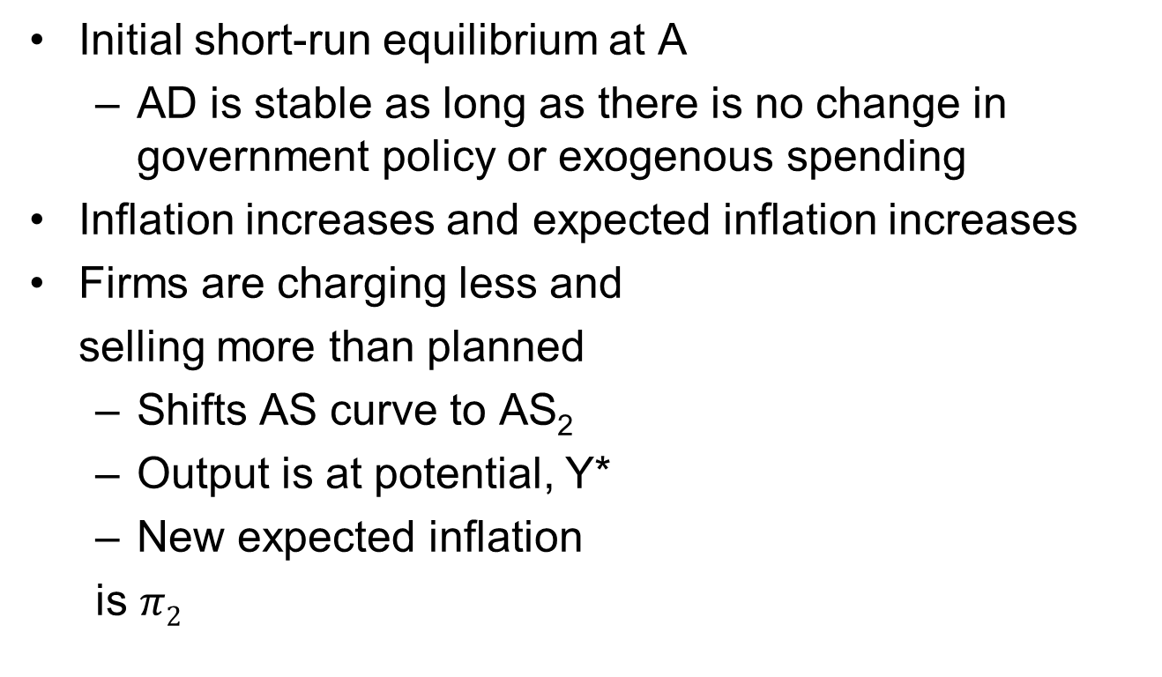


An Expansionary Gap
AS₂
AS₁
$$π2$$
Inflation (π)
$π$₁
A
AD
Expected inflation is given by the AS curve at potential output
Y*
Y₁
Output Y

Slide 30
Adjustment from an Expansionary Gap
When output is above potential output, firms increase prices faster than expected inflation rate
  Causes inflation to increase above expected level
  Expected inflation rises, workers demand for higher wages, firms employ less workers, produce less output, AS decreases, AS curve shifts left
  As inflation increases, consumption and planned investment spending decrease, PAE decrease, movement up AD curve, output decreases
Process continues until the economy reaches equilibrium at the potential level of output
  Actual inflation is higher than initial level of inflation

Slide 31


A Recessionary Gap
Initial equilibrium is at A
  AD curve remains stable unless government policy or exogenous spending changes
When inflation rate is below expected value, expected inflation decreases, wage decreases
  AS curve shifts to AS₂
New long run equilibrium
  At potential rate Y*
  Inflation rate π₂
AS₁
AS₂
A
$π$₁
Inflation (π)
$$π2$$
AD
Y₁
Y*
Output Y

Slide 32
Self-Correcting Economy
In the long-run the economy tends to be self-correcting
  Missing from Keynesian model
  Keynesian model is short-run; no price adjustments
Given time, output gaps disappear without any changes in monetary or fiscal policy
Whether stabilization policies are needed depends on the speed of the self-correction process
  If the economy returns to potential output quickly, stabilization policies may be destabilizing
  The greater the gap, the longer the adjustment period

Slide 33
Self-Correcting Economy
A slow self-correcting mechanism
  Fiscal and monetary policy can help stabilize the economy
A fast self-correcting mechanism
  Fiscal and monetary policy are not effective and may destabilize the economy
The speed of correction will depend on
    The use of long-term contracts
    The efficiency and flexibility of labor markets
  Fiscal and monetary policy are most useful when attempting to eliminate large output gaps

Slide 34
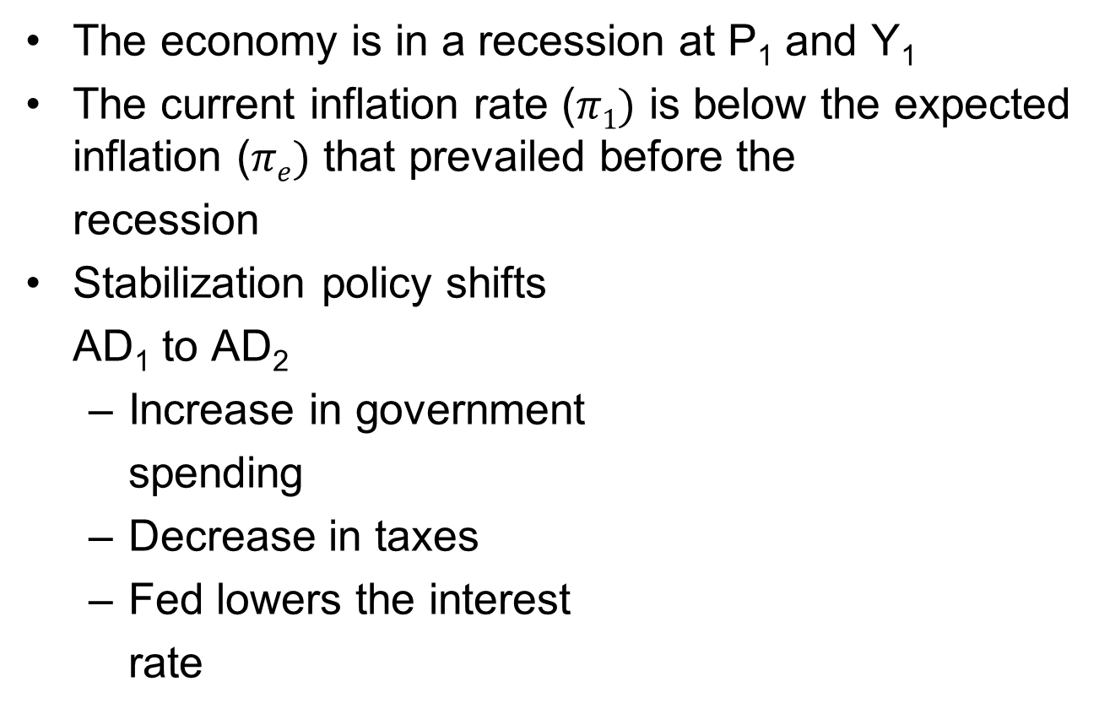
Stabilization Policy and Demand Shocks
AS₂
π^{e}
Inflation (π)
AD₂
AD₁
Y ₁
Y*
Output Y

Slide 35
Responding to Aggregate Inflation Shocks
The economy begins in long-run equilibrium at Y₁, π₁
Adverse inflation shock shifts aggregate supply to AS₂
  Recessionary gap at Y₂
  with higher inflation, π₂
  The central bank can
  Choose to:
    Close the recessionary gap
    Restore target inflation rate
LRAS
AS₂
AS₁
π₂
Inflation (π)
π₁
AD₁
Y₂
Y ₁
Output (Y)

Slide 36
Accommodating an Aggregate Inflation Shock
Suppose the central bank moves to close the recessionary gap
  Eases monetary policy, lowering interest rates at π₂
    Resets target inflation rate to π₃
  Lower interest rates
  stimulate consumption and
  investment spending
    AD shifts to AD₂
  Long-run equilibrium is now
  at Y₁ and π₃
Aggregate inflation shock
leads to higher long-run
inflation
LRAS
AS₂
π₃
AS₁
π₂
Inflation (π)
π₁
AD₂
AD₁
Y₂
Y ₁
Output (Y)

Slide 37
Responding to An Aggregate Inflation Shock
Suppose the central bank decides to maintain inflation at π₁
  Actual inflation is π₂
  Along AS₂, expected inflation is π₃
  When the central bank fails
  to respond with looser
  monetary policy, expected
  inflation decreases
  AS₂ shifts back to AS₁
  Original long-run equilibrium
  is restored
LRAS
AS₂
π₃
AS₁
π₂
Inflation (π)
π₁
AD₁
Y₂
Y ₁
Output (Y)

Slide 38
Anchored Inflationary Expectations
Anchored inflationary expectations means people's expectations of future inflation do not change even if inflation rises temporarily
  Inflation anchoring dampens response to an aggregate inflation shock
  Businesses and consumers believe the central bank will reestablish its target inflation rate
  Shortens the time required to close the recessionary gap from the shock
    Encourages central bank to maintain its original inflation target

Slide 39
Credibility of Monetary Policy
Credibility of monetary policy is the degree to which the public believes the central bank will defend its target inflation rate
  More credible policy, more inflation is anchored
Factors that affect credibility
  Degree of central bank's independence
  The announcements of explicit inflation targets
  Established reputation for fighting inflation
Announced target of inflation adds to credibility of monetary policy and strengthens anchoring
  Reduce uncertainty in the financial markets

Slide 40
Central Bank Independence
Central banks insulated from short-term issues are better able to stabilize the economy
Indicators of independence are
  Length of appointments to the central bank
  Whether the central bank's actions are subject to frequent interference
  Whether the central bank has obligation to finance the national deficit
  The degree to which the central bank's budget is controlled by the legislative or executive branch
Countries with independent central banks have lower inflation

Slide 41
Central Bank Reputation
A central bank's success at stabilizing the economy depends on whether its acts align with its reputation
  Inflation hawk is committed to achieving and maintaining low inflation,
    Accepts some short-run cost in reduced output and employment
  Inflation dove is not strongly committed to achieving and maintaining low inflation
Inflation hawks are more successful in maintaining stable output and employment, even in the short run
  Stronger anchoring of inflation expectations

Slide 42
Supply Side Economics
Tax rates reduction increase aggregate spending through the consumption function
  Shifts aggregate demand to the right
Supply-side effects shift long-run aggregate supply
Whether inflation increases,
decreases, or stays
constant depends on the
relative sizes of the shifts
in AD and LRAS
Weak empirical support for
Supply side economics
LRAS₁
LRAS₂
Inflation (π)
π₁
AD₂
AD₁
Y ₁
Y ₂
Output (Y)

Slide 43
Effectiveness of Policymaking
Macroeconomic policy works best with
  Accurate knowledge of current economic conditions
  Knowledge of the future path of the economy without policy
  Precise value of potential output
  Good control of fiscal and monetary policies
  Knowledge of how and when the economy will respond to policy changes

Slide 44
Barriers to Perfect Policies
Policy makers act with an approximate understanding of the economy
Policy is subject to lags
  The inside lag is the delay between the time a policy change is needed and the time it is implemented
    Shorter for monetary policy than for fiscal policy
  The outside lag is the delay between policy implementation and the major effects of the policy occur
    Longer for monetary policy than for fiscal policy

Slide 45
Thank You
This is the end of Lecture 11.
Thank you for your participation.
Please send your query to me via my email at khayboon@ntu.edu.sg.

